Slide 1

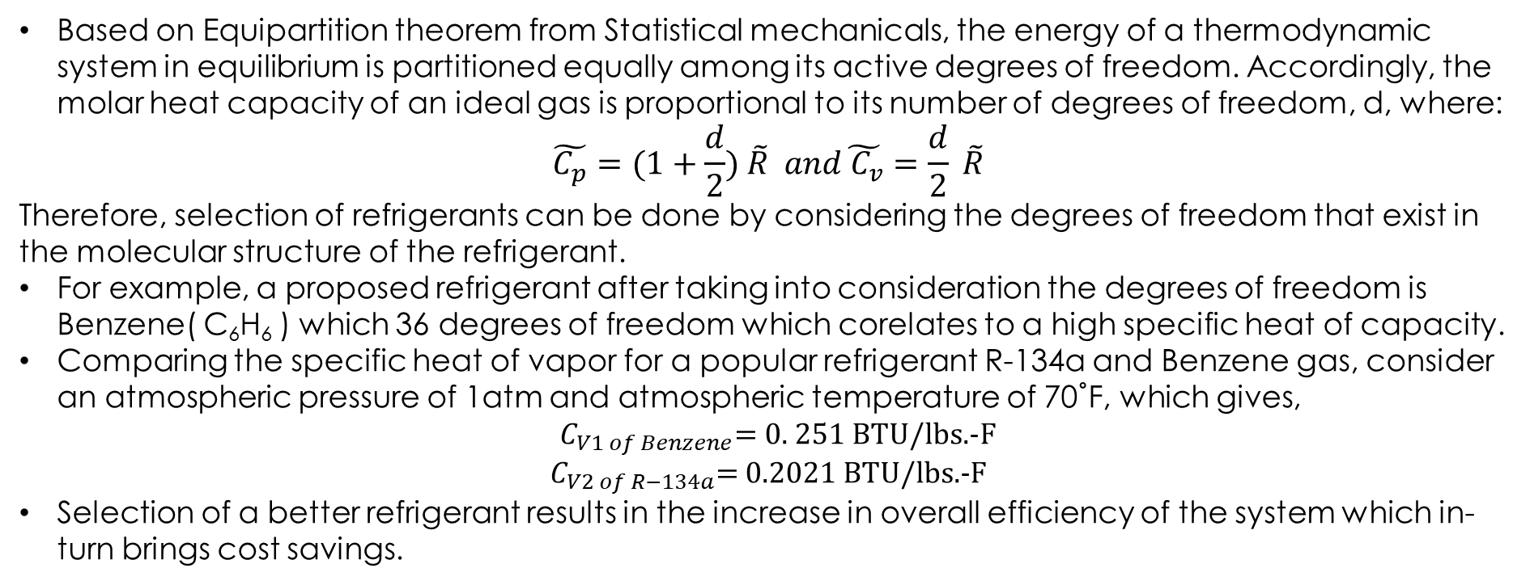
IMPROVEMENT IN SELECTION OF REFRIGERANTS
DONE BY: VARUN SUBRAMANIAN, SANDEEP RAMESH MOUDGALYA, NIRIKSHITH VENUGOPAL HRISHIKESH RAO, ANIKETH LOLAM
Based on Equipartition theorem from Statistical mechanicals, the energy of a thermodynamic system in equilibrium is partitioned equally among its active degrees of freedom. Accordingly, the molar heat capacity of an ideal gas is proportional to its number of degrees of freedom, d, where:
$$\tilde{C_{p}}=(1+\frac{d}{2}) \tilde{R} and\tilde{{ C}_{v}}=\frac{d}{2} \tilde{R}$$
Therefore, selection of refrigerants can be done by considering the degrees of freedom that exist in the molecular structure of the refrigerant.
For example, a proposed refrigerant after taking into consideration the degrees of freedom is Benzene( C₆H₆ ) which 36 degrees of freedom which corelates to a high specific heat of capacity.
Comparing the specific heat of vapor for a popular refrigerant R-134a and Benzene gas, consider an atmospheric pressure of 1atm and atmospheric temperature of 70˚F, which gives,
${ C}_{V1 of Benzene}=$ 0. 251 BTU/lbs.-F
$C_{V2 of R−134a}$= 0.2021 BTU/lbs.-F
Selection of a better refrigerant results in the increase in overall efficiency of the system which in-turn brings cost savings.
Notes:
Good morning
Our project revolves around the selection of Refrigerants in the Vapor-compression refrigeration cycle.
We find that refrigerants with higher Specific heat capacities in the vapor state have higher COPs.
So what decides the Specific heat capacity?
We find that the Molar specific heat capacity is proportional to the number of active degrees of freedom.
To convert this to mass specific heat capacity, we divide by Molecular Mass.
So a high specific heat capacity is one where the number of degrees of freedom is high and the molecular mass is low.
For example we have benzene with 36 DOF, and comparatively low molecular mass, being comprised only of carbon and hydrogen has a much higher Specific heat capacity than R-134a.
We plan to explore more refrigerant options which provide a better COP as well as being safe to use.

